Slide 1
Xiao Ji Tian
Software Engineer
08/23/2013
Product Implementation Training (PIT)
IBM Case Manager 5.2 Javascript Toolkit - UI Class

Slide 2
Introduction
Course Overview
IBM Case Client UI Concepts
Page widget
Page
Container
Event
Coordination
Target Audience:
Business Partner and Developer
Prerequisites:
IBM Content Navigator
Version Release Date Q3, 2013
© Copyright International Business Machines Corporation 2012. All Rights Reserved.
US Government Users Restricted Rights - Use, duplication or disclosure restricted by GSA ADP Schedule Contract with IBM Corp.

Slide 3
Course Objectives
After this course you will be able to:
Understand ICM runtime UI framework;

Slide 4
UI Level Concepts
Page widget
Self contain visual component with both UI and business logic
Page
Visual component composed of several page widgets, which work together by means of event and coordination to fulfill larger function.
Container widget
The content pane of the case feature.
It provides a selector for user can selecting a solution and role.
It manages the pages.
Notes:
An IBM Case Manager Page widget is a particular visual component contains both UI and business logic, and rely on IBM Content Navigator and IBM Case Manager model layer for data CRUD, which is a classic MVC unit with event interface. Usually, page widget expose configurable preferences for Business Analyst to customization. Page widgets are designed to be reusable; usually, they are self-contained and just take a single responsibility.
An IBM Case Manager page is visual component composed of several page widgets, which work together to fulfill larger function. The page controls the layout of page widgets, setup the event wiring between page widgets, and service as an event broker routing the event from publisher to handler. Unlike IBM Content Navigator visual components, page is no longer a MVC unit, there is not a centralized controller between page widgets; they work together by means of unidirectional communication (event) and bidirectional communication (coordination). In a page, if a page widget does not fit to a custom solution, it can be replaced by custom page widget.
The IBM Case Manager container widget is the content pane of the case feature. It provides a selector for user can selecting a solution and role. Container will show the pages associated with the role in a tab container. By default, there are cases and work pages. User could start working from these pages, launching case and work items in new pages for further processing.

Slide 5
UI Level Concepts
Event
Event mechanism provides the unidirectional communication means from one page widget to another page widget(or container).
Coordination
Coordination mechanism provides the bidirectional communication means between page widgets.

Slide 6
Page widget
Basically, page widget is indeed a dojo dijit. Also, page widget is an event endpoint and a container of actions. Dojo dijit programming guide is the primary guide for developing a page widget. The lifecycle of page widget is typical dojo dijit lifecycle, which connect to its parent page’s life cycle.(page is also a dijit)

Slide 7
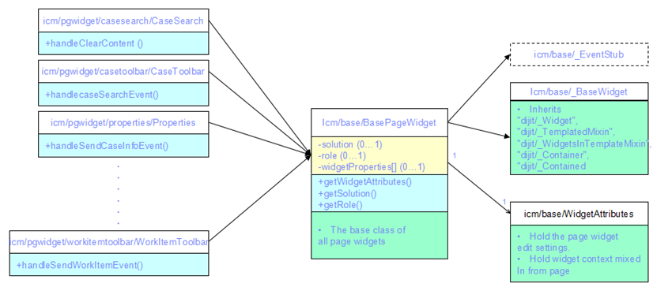
Page widget - class diagram

Slide 8
Page widget - classes
Configuration
Page widget has preferences for configuration. In page designer, Business Analyst could customize a page widget by configure its specific preferences, add/remove actions and enable/disable event broadcasting. In runtime, the configuration will be mixed in to the page widget by its parent page; the page widget will behave according to the configurations.
Event stub
Page widget and the its actions both publish events through the page widget’s event stub functions. It’s not necessary to make distinguish if an event is published by the page widget or its actions.
Share model and coordination
In some scenarios, page widgets in page need to bidirectional communication to fulfill a function, e.g. the workitem toolbar tell properties widget and attachment widget to update their changes into the share workitem editable object, then it commits the changes in the editable model object to server after the properties and attachment widgets both tell that their changes has been updated. The coordination object is used for the purpose. Usually, a topic is selected for coordination; one page widget (e.g. toolbar) joins the topic coordinator, other page widgets join the topic as participator (e.g. properties and attachment).
Page widget context
The page widgets inside an IBM Case Manager page could expect that its parent page will mix in the working context of current solution and role to it.
Customization
Developer could follow the MVC pattern to build custom page widget by leveraging existing IBM Content Navigator/IBM Case Manager model APIs and visual components. Also, many IBM Case Manager page widgets expose extension point APIs for customization. Developers could build customized IBM Case Manager page widgets by inheriting from the IBM Case Manager OOTB page widgets and overriding the extension point APIs.

Slide 9
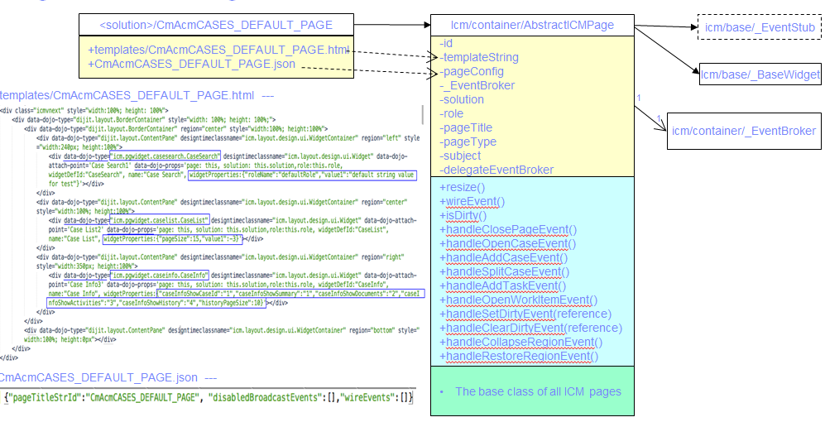
Page - class diagram
Notes:
The generated page source files could be found in DOS/<Solution>/pages

Slide 10
Page - components
Page is also a dojo dijit. It is consist of three parts,
A page dijit class inherits from IBM Case Manager/container/AbstractICMPage.
An html template embeds page widgets in <div/> using data-dojo-type with their configuration in data-dojo-props.
A JSON format configuration file contains the configuration of page title, event wiring and disabled broadcast events.

Slide 11
Page - events and regions
Page lifecycle events
The page and all page widgets are all ready to work.(icm.PageOpened)
The page is going to be closed.(icm.PageClosing)
The page is selected in tab container.(icm.PageActivated)
The page is unselected in tab container.(icm.PageDeactivated)
Page regions
In page designer, the page’s layout is divided into several regions (e.g. top, bottom, heading, center, trailing), and page widgets are resident in those regions. For purpose of better managing the screen real state fits to user’s current work, page widget could publish event to collapse and restore a region, and page can handle the page layot control events.
Command events
There is a set of broadcast events serve the IBM Case Manager domain objects’ creation and editing, e.g. ‘icm.OpenCase’, ‘icm.OpenWorkItem’ and ‘icm.AddCase’. They are so called command events. Basically, the IBM Case Manager command events are published by actions and handled by IBM Case Manager container, which will open a proper page for processing the action according to the configuration of the current case, work item, solution and role. With an IBM Case Manager command event broadcasting disabled, and wiring to a custom command event handler, custom could override the default IBM Case Manager behaviors, e.g. open a case in a dialog.

Slide 12
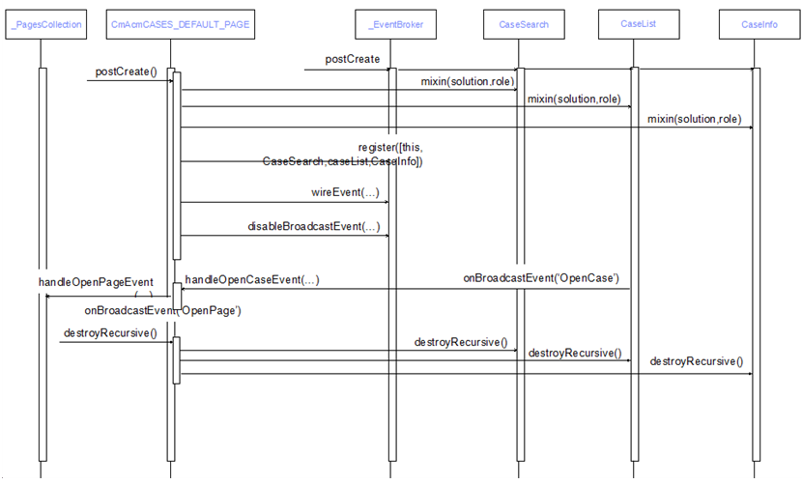
Page -setup and teardown

Slide 13
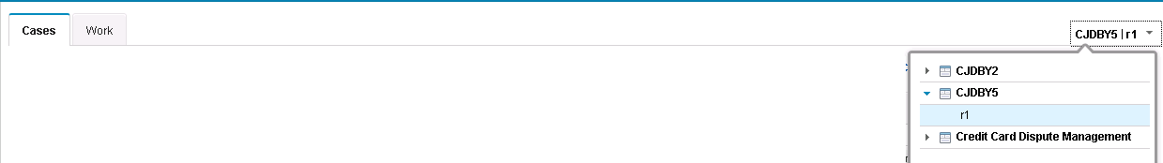
Container
Solution and role selector
At runtime, the container is responsible to manage the pages. In GUI, container has a solution and role selector for user to choose the solution and role he or she want to start work with. When solution and role are determined, it manages the pages in a tablized manner. Those static page can’t be manually closed, and always be there unless user switch solution or role. Those dynamic pages can be created for a work as need, and be closed when its work finished, then container will switch to the last selected page. The container also remember the latest user selected solution and role before user quit the IBM Case Manager client, and goes to same solution and role the next time user login.
Manage pages associated with a role
In design time, when design a solution; Business analyst can associate a set of pages with a role which serving different user scenarios. Conceptually, the set of pages divide into two categories. One category is the static page, which is the initial set of pages the role members can start to work with, e.g. the case page and work page. Another category is the dynamic page, which could be launched from those static pages, e.g. the case detail page.
Page addressibility
It is common that a user need to reference a case or a work item in an email or a web page. IBM Case Manager client supports to generate the URL addresses in case list and in-basket page widget. And, the container can digest the URL addresses to open a right detail page for the case or work item.

Slide 14
Event
IBM Case Manager Client support event broadcasting, event wiring and publishing event cross pages.
The event mechanism is built on top of dojo/topic APIs, with additional scope for limit the event publish/subscribe just inside a page rather than global.

Slide 15
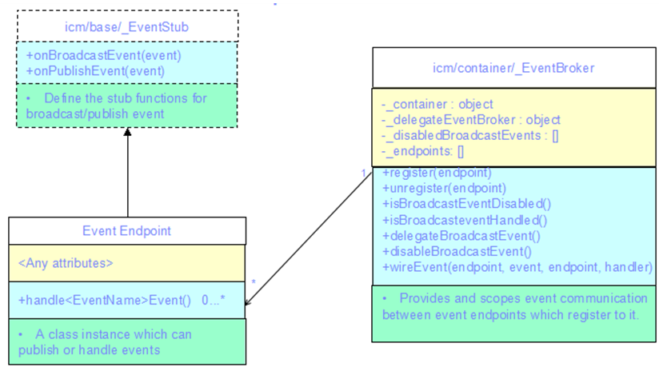
Event - class diagrem

Slide 16
Event - classes
The Event endpoint could be any dijit class, which wants to publish/subscribe events.
It requires the dijit class has the functions of onBroadcastEvent(), onPublishEvent() for publishing events.
and handle<EventName>Event() for hadling specific event of <EventName>.
Usually, an event endpoint is inherited from _EventStub. The two functions defined are simply stub functions for _EventBroker to hook on.
A group of event endpoints can talk to each other if they are register to same _EventBroker.
Usually, each page has a _EventBroker, those page widgets inside a page can talk through the _EventBroker.
When page widget calls the event stub functions with event id and event payload passing as parameters, the _EventBroker will route the event to right event handler.

Slide 17
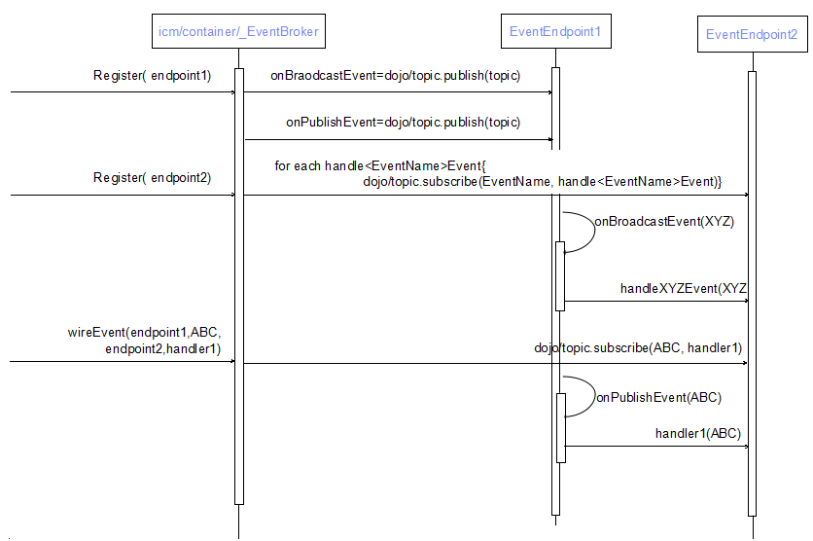
Endpoint register and event publish and handle
Notes:
When register a event endpoint to a _EventBroker, it will scan and hooks up to the event stub functions of onBroadcastEvent()/onPublishEvent, and setup publish/subscribe topics for handle<EventName>Event function.(<EventName> can be any event name)
When a event endpoint calls its onBroadcastEvent() with event of XYZ, the handleXYZEvent() function on another event endpoint will be called with event XYZ as parameter. (The _EventBroker matches the event handler with naming conversion of handle<EventName>Event)
If a event wiring was added, when the publish event broker calls its onPublishEvent() with the event of XYZ, the event handler function of the subscriber endpoint will be called with the event XYZ as parameter.
Any broadcast event will also be published at first.

Slide 18
Coordination
In some IBM Case Manager scenarios, it’s necessary to have several page widgets coordinate to work together to fulfil a work.
For example, in work item form page, there are three page widgets – form, attachment and work item toolbar. User click on save action button in work item toolbar. It takes several steps of coordination to fulfil the save.
The coordination between page widgets has characters of
Bi-directional communication.
Fine granularity steps of coordination.
Notes:
The work item toolbar asks all page widgets commit changes . Each page widget commits its change, then notify the work item toolbar. After all page widgets complete their works, the work item toolbar move to data validation step.
The work item toolbar asks all page widgets check if there are any validation errors. After every page widgets finish validation, they notify the work item toolbar, it move to before save step.
In before save step, form widget saves the form itself as an attachment of the work item. Then, it notifies the work item toolbar to move to next step.
The next step is save step, here; the work item toolbar commits the changed model to server. Next, the work item toolbar start the after save step.
In after save step, the form page widget and attachment widget clear their dirty state, and notify the work item toolbar of their completion. Until now, the coordination between page widgets for the save action complete.

Slide 19
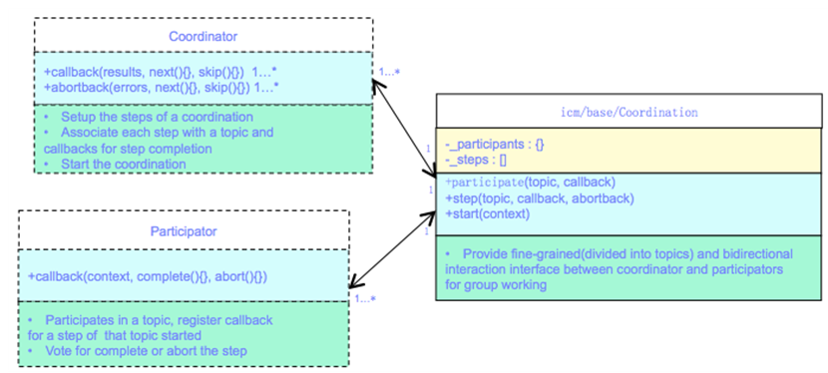
Coordination - class diagrem

Slide 20
Coordination - classes
The IBM Case Manager/base/Coordination is a utility class for the coordination between page widgets. There are three parts consistent of coordination,
one coordinator,
multiple participators
and several coordination topics
A coordination could have several fine granularity steps. Each step associates with a coordination topic, which is a subject for coordinator and participators to join together.
A coordinator can define the coordination steps and related topics, then start and control the coordination flow.
A participate could join any interested topic; work for a topic when it starts and feed the result back to the coordinator.
A coordination object will be created and put in the initial event broadcasted in detail page, page widget could fetch it using the id of ‘coordination’

Slide 21
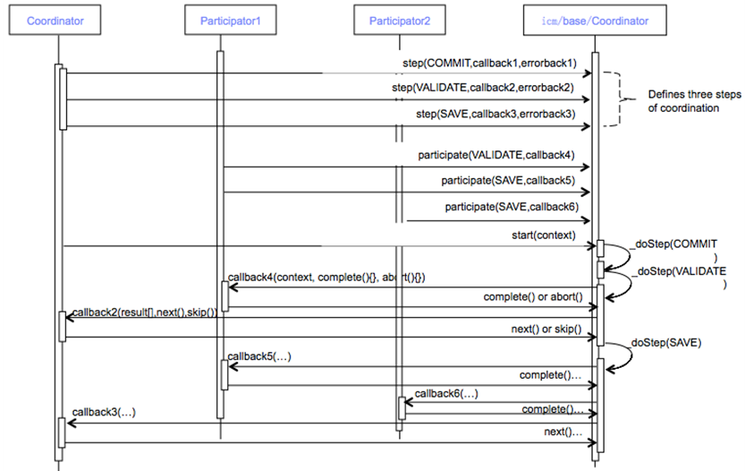
Coordination
Notes:
A coordinator set up a sequence of coordination topics (e.g. beforeSave, Save, afterSave) by step(topic) function, and registers callback and errback to be called when all participator complete their works. The participators register callbacks to the interested topic. After coordinator starts the coordination, the coordination topics will be started in an order defined by the steps. When a coordination topic started, every registered participator’s callbacks will be called with the complete() and abort() function pass in as parameter, they call the complete() function with the result as parameter to tell coordination that they fulfill their works, or they call the abort() function with a error as parameter to tell coordination that they finish their work with error. After each participator callbacks finished, the participator’s register callback or errback will be called with all participators’ results in an array as parameter. In the callback, two functions are pass in as parameters next() and skip(), according to the results, it can determine if it want to process the next coordination topic by calling the next(), or skip the remaining topics by calling skip().

Slide 22
Product Help/Documentation/Resources
IBM Case Manager 5.2 Infocenter
IBM Case Client development Guide
IBM Case Client JSDocs
IBM Content Navigator infocenter
IBM Case Client Programming Guide Overview and Tutorial

